Slide 1

DriverPass System Analysis
Tristan Maloy
Notes:
Hello Liam, and stakeholders of DriverPass. My name is Tristan Maloy and I will be presenting the system analysis for the DriverPass application.

Slide 2

System Requirements
Functional Requirements
The system shall offer multiple packages for the user to choose from.
Admin role can disable packages
The system shall let the user, admin, IT, or secretary to schedule and maintain appointments
Nonfunctional Requirements
The system shall be scalable
The system will run using a cloud-based server
Notes:
The first thing to mention is the system requirements. The system will have to meet certain expectations upon launch so these are some of the things that will be required for the system to function based on the needs of your business.
Functional Requirements are requirements on the different features that the system will have. DriverPass is currently wanting to offer three different driving packages with different features for the customer to choose from, so the system will be able to offer and showcase each of the three packages that the customer can choose from. If a package gets overloaded with customers and the business is not able to keep up with appointments, Liam, who will have the role of admin, will be able to disable the package from further use until the overload is taken care of. The system will also allow users the ability to schedule and maintain their own appointments, while allowing other roles the ability to schedule and maintain for them in the event of an over the phone scheduling or IT issue.
Nonfunctional requirements are the things that the system will need to do to allow functionality and satisfy the needs of the system itself. For example, the system will also need to support multiple roles such as the admin role, the secretary role, the IT officer role, and the user role. This will support the functional requirement of scheduling by allowing specific users access to that information. The system will also be scalable, which will allow the system and server to grow in case there is an influx of customers. This means that the system will be less likely to crash due to an overload of users at the same time. The last nonfunctional requirement I will mention is that the system will run using a cloud-based server. This will help allow roles such as Admin to see all data and information whenever they have internet access. To ensure the application runs when not online, it is also a requirement that when not connected to the internet, data can be stored locally until the next time the user connects to the internet.

Slide 3
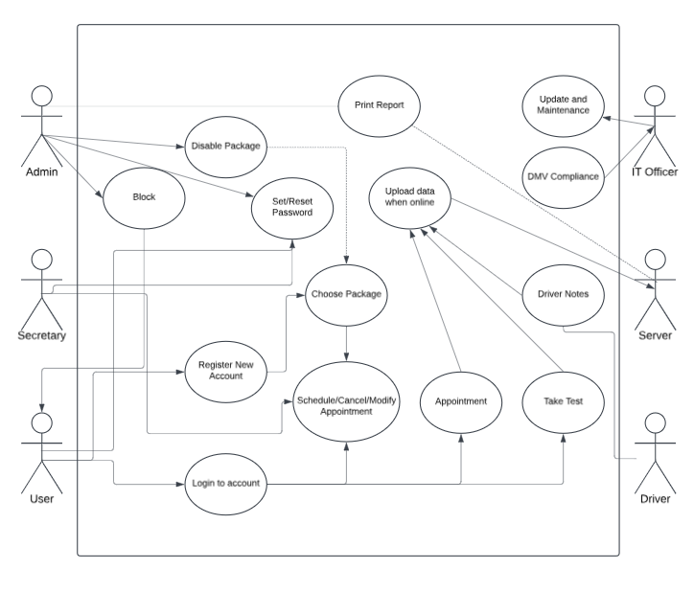
Use Case Diagram
Notes:
The diagram shows all the different external entities that will interact with the system, as well as what each entity has access to. On the left-hand side of the diagram, there are the User, the Secretary, and the Admin. These are the three main roles that will interact with processes such as account maintenance. The admin has access to printing reports from the server, disable a package, block a user from access to the system, and set/reset passwords. The secretary also has access to set/reset passwords but is more integral in appointment maintenance so they will have access to scheduling, canceling, and modifying appointments. The user will have access to log into their account or register for a new account. Registering for a new account also grants the user access to choose a package. Once they are logged in, they can schedule/cancel/modify appointments, check in for their appointment, or take tests. When a user attends an appointment, or takes a test, the data from each respective event gets uploaded either to the server, or locally until there is proper access to the server.
On the right-hand side, the IT officer has access to update and maintain the system. Part of the maintenance that is included in the IT Officer job is ensuring DMV compliance is up to date. Finally, the driver (or instructor) gets access to the driver notes after each appointment while also gets uploaded to the server.

Slide 4
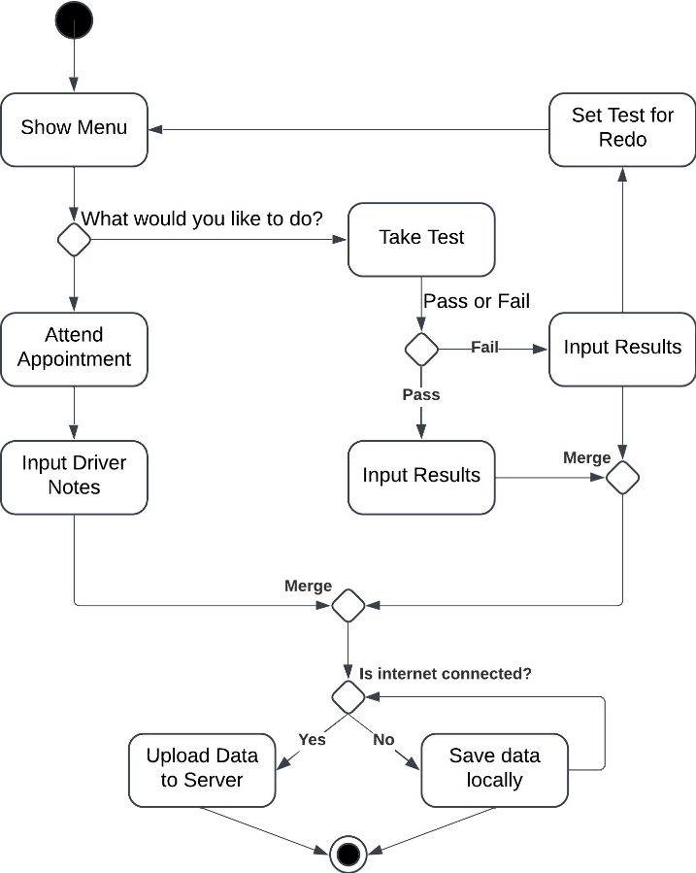
Activity Diagram
Notes:
This diagram shows how activities such as attending an appointment and taking a test flow through the system. The first thing that the system should do is show the menu. From there the user can choose to either attend their scheduled appointment or take a test. This is where the diagram branches off. If the user chooses to attend an appointment, the next step in the system is for the driver instructor to input their driver’s notes. If the user chooses to take a test, the system then allows the user to take the test. The diagram branches off here again, as the user can either pass or fail the test. If the user fails the test, the test results get input, and the test is set to redo where the user is then directed back to the menu. If the user passes the test, the results get input and the diagram continues. Once the results get input, the diagram merges as the results then need to get saved. This is also the next step after the driver’s notes get input. From here, the data, whether it is from the driver notes, or from the test results, gets saved locally, or uploaded to the server. This decision is dependent on if the system is connected to the internet. If the system is connected to the internet, the data will be saved to the server. If not, the data will get saved locally and continue in a loop to check if there is an internet connection until the system is connected to the internet and the data is uploaded to the server. This marks the end of the activity diagram.

Slide 5
Security
RESTful APIs
HTTPS
Two Factor Authentication
Strong Passwords
Reset Password Link
Notes:
Security is huge in system design. Certain authentication protocols will be implemented in the way of RESTful APIs. RESTful APIs establish a connection between the system and the server so data can be transferred between the two. This will help with performance, as well as supporting large numbers of users and preventing failures within the system data. RESTful APIs help aid in the authentication and authorization of user roles.
Utilizing HTTPS will also boost security as it will encrypt data as it travels from the client/system to the server. This helps to ensure data integrity by ensuring encryption is the event of an attack on the system.
Two Factor authentication will require all users to have a second form of identification other than username to login. This normally is by a code sent via text to the user’s phone number on the account, or by a third-party authenticator app. This helps prevent hackers from accessing user’s profiles by having that unique second form of ID.
Passwords will also be required to be strong. This means setting password requirements such as the password length needs to be 15 characters+, including a capital letter, lowercase letter, a number, and a special character such as a ! @ $ etc.…
The users will also have access to a reset password link. If a hacker fails to get into the users’ account, or the account is signed in at an unusual location, then an email will be sent to the user with a reset password link encouraging the user to reset their password.

Slide 6
System Limitations
Updates when online
Completion by May 10th
Budget not discussed
Compliant with DMV policies and rules
Notes:
Limitations tend to be things that can be fixed or need to be communicated. The first limitation to mention is the fact that the system will only be able to update and upload data when online. This might cause problems if the system was to get hacked and the data was lost.
Based on the requirements and the needs of your business, there is a timeline limit which requires the system to be 100% completed and able to launch on May 10th.
Budget was never discussed during the initial interview. This is something that needs to be figured out as it can severely hinder or support the development process depending on which way the budget goes.
The last system limitation to note is that the system will need to always be compliant with DMV policies and rules. There are liability issues if the system is not up to date with DMV compliance, so this is mandatory and not optional for the system to keep up with.

